Slide 1
GSM Security Overview (Part 2)
Max Stepanov

Slide 2
Agenda
GSM Security Objectives
  Concerns, Goals, Requirements
GSM Security Mechanisms
SIM Anatomy
Algorithms and Attacks
  COMP128
  Partitioning Attack on COMP128
  (J. Rao, P. Rohantgi, H. Scherzer, S. Tunguely)

Slide 3
GSM Security Concerns
Operators
  Bills right people
  Avoid fraud
  Protect Services
Customers
  Privacy
  Anonymity
Make a system at least secure as PSTN

Slide 4
GSM Security Goals
Confidentiality and Anonymity on the radio path
Strong client authentication to protect the operator against the billing fraud
Prevention of operators from compromising of each others’ security
  Inadvertently
  Competition pressure

Slide 5
GSM Security Design Requirements
The security mechanism
  MUST NOT
    Add significant overhead on call set up
    Increase bandwidth of the channel
    Increase error rate
    Add expensive complexity to the system
  MUST
    Cost effective scheme
  Define security procedures
    Generation and distribution of keys
    Exchange information between operators
    Confidentiality of algorithms

Slide 6
GSM Security Features
Key management is independent of equipment
  Subscribers can change handsets without compromising security
Subscriber identity protection
  not easy to identify the user of the system intercepting a user data
Detection of compromised equipment
  Detection mechanism whether a mobile device was compromised or not
Subscriber authentication
  The operator knows for billing purposes who is using the system
Signaling and user data protection
  Signaling and data channels are protected over the radio path

Slide 7
GSM Mobile Station
Mobile Station
  Mobile Equipment (ME)
    Physical mobile device
    Identifiers
      IMEI – International Mobile Equipment Identity
  Subscriber Identity Module (SIM)
    Smart Card containing keys, identifiers and algorithms
    Identifiers
      K_{i} – Subscriber Authentication Key
      IMSI – International Mobile Subscriber Identity
      TMSI – Temporary Mobile Subscriber Identity
      MSISDN – Mobile Station International Service Digital Network
      PIN – Personal Identity Number protecting a SIM
      LAI – location area identity

Slide 8
GSM Architecture
Mobile Stations
Base Station
Subsystem
Network
Management
Subscriber and terminal
equipment databases
OMC
BTS
Exchange
System
VLR
MSC
BTS
BSC
HLR
AUC
BTS
EIR

Slide 9
Subscriber Identity Protection
TMSI – Temporary Mobile Subscriber Identity
  Goals
    TMSI is used instead of IMSI as an a temporary subscriber identifier
    TMSI prevents an eavesdropper from identifying of subscriber
  Usage
    TMSI is assigned when IMSI is transmitted to AuC on the first phone switch on
    Every time a location update (new MSC) occur the networks assigns a new TMSI
    TMSI is used by the MS to report to the network or during a call initialization
    Network uses TMSI to communicate with MS
    On MS switch off TMSI is stored on SIM card to be reused next time
  The Visitor Location Register (VLR) performs assignment, administration and update of the TMSI

Slide 10
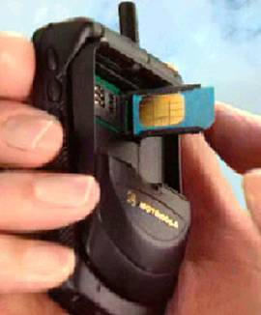
Key Management Scheme
K_{i} – Subscriber Authentication Key
  Shared 128 bit key used for authentication of subscriber by the operator
  Key Storage
    Subscriber’s SIM (owned by operator, i.e. trusted)
    Operator’s Home Locator Register (HLR) of the subscriber’s home network
SIM can be used with different equipment

Slide 11
Detection of Compromised Equipment
International Mobile Equipment Identifier (IMEI)
  Identifier allowing to identify mobiles
  IMEI is independent of SIM
  Used to identify stolen or compromised equipment
Equipment Identity Register (EIR)
  Black list – stolen or non-type mobiles
  White list - valid mobiles
  Gray list – local tracking mobiles
Central Equipment Identity Register (CEIR)
  Approved mobile type (type approval authorities)
  Consolidated black list (posted by operators)

Slide 12
Authentication
Authentication Goals
  Subscriber (SIM holder) authentication
  Protection of the network against unauthorized use
  Create a session key
Authentication Scheme
  Subscriber identification: IMSI or TMSI
  Challenge-Response authentication of the subscriber by the operator

Slide 13
Authentication and Encryption Scheme
Mobile Station
Radio Link
GSM Operator
Challenge RAND
SIM
K_{i}
A3
A3
K_{i}
Signed response (SRES)
SRES
SRES
A8
A8
Authentication: are SRES values equal?
F_{n}
K_{c}
K_{c}
F_{n}
m_{i}
A5
Encrypted Data
A5
m_{i}

Slide 14
Authentication
AuC – Authentication Center
  Provides parameters for authentication and encryption functions (RAND, SRES, K_{c})
HLR – Home Location Register
  Provides MSC (Mobile Switching Center) with triples (RAND, SRES, K_{c})
  Handles MS location
VLR – Visitor Location Register
  Stores generated triples by the HLR when a subscriber is not in his home network
  One operator doesn’t have access to subscriber keys of the another operator.

Slide 15
A3 – MS Authentication Algorithm
Goal
  Generation of SRES response to MSC’s random challenge RAND
RAND (128 bit)
A3
K_{i} (128 bit)
SRES (32 bit)

Slide 16
A8 – Voice Privacy Key Generation Algorithm
Goal
  Generation of session key K_{s}
    A8 specification was never made public
RAND (128 bit)
A8
K_{i} (128 bit)
K_{C} (64 bit)

Slide 17
Logical Implementation of A3 and A8
Both A3 and A8 algorithms are implemented on the SIM
  Operator can decide, which algorithm to use.
  Algorithms implementation is independent of hardware manufacturers and network operators.

Slide 18
Logical Implementation of A3 and A8
COMP128 is used for both A3 and A8 in most GSM networks.
  COMP128 is a keyed hash function
RAND (128 bit)
COMP128
K_{i} (128 bit)
128 bit output
SRES 32 bit and K_{c} 54 bit

Slide 19
A5 – Encryption Algorithm
  A5 is a stream cipher
    Implemented very efficiently on hardware
    Design was never made public
    Leaked to Ross Anderson and Bruce Schneier
  Variants
    A5/1 – the strong version
    A5/2 – the weak version
    A5/3
      GSM Association Security Group and 3GPP design
      Based on Kasumi algorithm used in 3G mobile systems

Slide 20
Logical A5 Implementation
Mobile Station
BTS
F_{n} (22 bit)
K_{c} (64 bit)
F_{n} (22 bit)
K_{c} (64 bit)
A5
A5
114 bit
114 bit
Data (114 bit)
XOR
Ciphertext (114 bit)
XOR
Data (114 bit)
Real A5 output is 228 bit for both directions

Slide 21
A5 Encryption
Mobile Stations
Base Station
Subsystem
Network
Management
Subscriber and terminal
equipment databases
OMC
BTS
Exchange
System
VLR
MSC
BTS
BSC
HLR
AUC
BTS
EIR
A5 Encryption

Slide 22
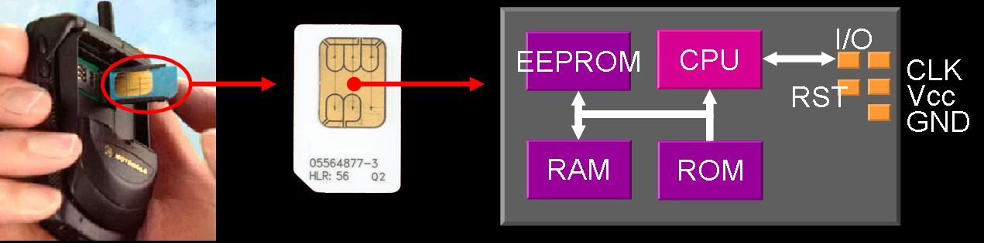
SIM Anatomy
  Subscriber Identification Module (SIM)
    Smart Card – a single chip computer containing OS, File System, Applications
    Protected by PIN
    Owned by operator (i.e. trusted)
    SIM applications can be written with SIM Toolkit

Slide 23
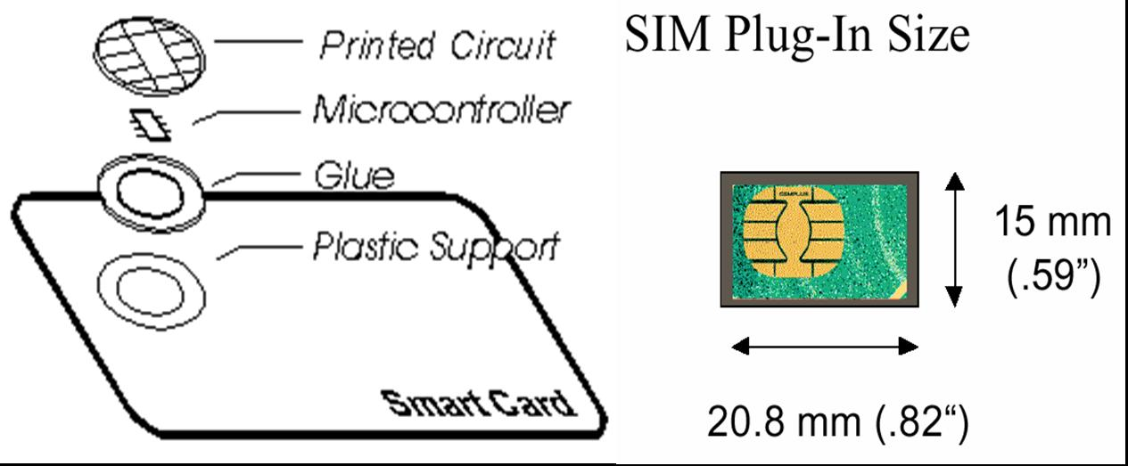
Smart Card Anatomy

Slide 24
Microprocessor Cards
Typical specification
  8 bit CPU
  16 K ROM
  256 bytes RAM
  4K EEPROM
  Cost: $5-50
Smart Card Technology
  Based on ISO 7816 defining
    Card size, contact layout, electrical characteristics
    I/O Protocols: byte/block based
    File Structure

Slide 25
Algorithm Implementations and Attacks

Slide 26
Attack Categories
SIM Attacks
Radio-link interception attacks
Operator network attacks
  GSM does not protect an operator’s network

Slide 27
Attack History
1991
  First GSM implementation.
April 1998
  The Smartcard Developer Association (SDA) together with U.C. Berkeley researches cracked the COMP128 algorithm stored in SIM and succeeded to get K_{i} within several hours. They discovered that Kc uses only 54 bits.
August 1999
  The week A5/2 was cracked using a single PC within seconds.
December 1999
  Alex Biryukov, Adi Shamir and David Wagner have published the scheme breaking the strong A5/1 algorithm. Within two minutes of intercepted call the attack time was only 1 second.
May 2002
  The IBM Research group discovered a new way to quickly extract the COMP128 keys using side channels.

Slide 28
COMP128
Keyed hash function

Slide 29
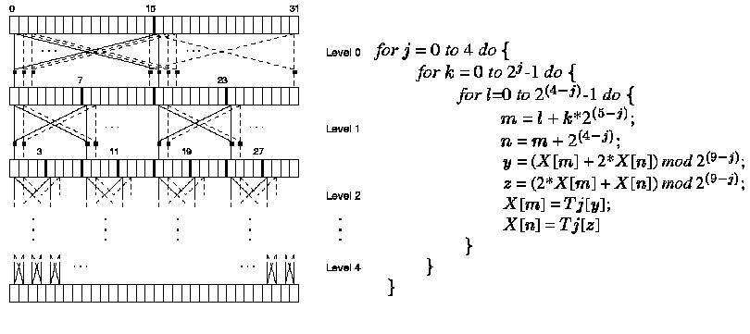
COMP128
Pseudo-code of the compression in COMP128 algorithm
  X[0..15] = K_{i}; X[16..31] = RAND;
  Lookup tables: T₀[512], T₁[256], T₂[128], T₃[64], T₄[32]

Slide 30
Traditional Cryptographic Assumptions
Traditional
Cryptographic
Attacks
Smart Card
Input
Crypto Processing
Output
Sensitive Information

Slide 31
Actual Information Available
Side Channel Attacks
Side Channels
  Power Consumption
  Electromagnetic radiation
  Timing
  Errors
  Etc.
Smart Card
Input
Crypto Processing
Output
Sensitive Information

Slide 32
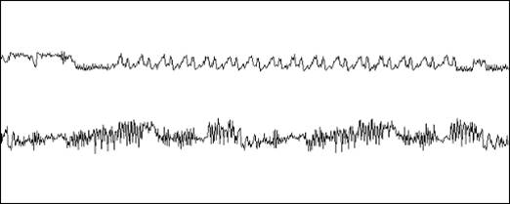
Simple Power DES Analysis
SPA of DES operation performed by a typical Smart Card
  Above: initial permutation, 16 DES rounds, final permutation
  Below: detailed view of the second and third rounds

Slide 33
Partitioning Attack on COMP128
Attack Goal
  K_{i} stored on SIM card
  Knowing K_{i} it’s possible to clone SIM
Cardinal Principle
  Relevant bits of all intermediate cycles and their values should be statistically independent of the inputs, outputs, and sensitive information.
Attack Idea
  Find a violation of the Cardinal Principle, i.e. side channels with signals does depend on input, outputs and sensitive information
  Try to exploit the statistical dependency in signals to extract a sensitive information

Slide 34
Partitioning Attack on COMP128
How to implement 512 element T₀ table on 8 bit Smart Card (i.e. index is 0..255)?
    Split 512 element table into two 256 element tables
It’s possible to detect access of different tables via side channels!
  Power Consumption
  Electromagnetic radiation

Slide 35
Partitioning Attack on COMP128
Pseudo-code of the compression in COMP128 algorithm
  X[0..15] = K_{i}; X[16..31] = RAND;
  Lookup tables: T₀[512], T₁[256], T₂[128], T₃[64], T₄[32]

Slide 36
Partitioning Attack on COMP128
0
15
16
32
X
K[0]
K[1]
…
K[15]
R[0]
R[0]
…
R[15]
T₀[y]
K[1]
…
K[15]
T₀[z]
R[0]
…
R[15]
y = K[0] + 2R[0]
z = 2K[0] + R[0]
Values of y and z depend on the first bytes of K and R
It’s possible to detect via side channels whether values of y and z are within [0..255] or [256..511].

Slide 37
Partitioning Attack on COMP128
All we need is…
  A) Find R[0] such that
    K[0] + 2R[0] (mod 512) < 256
    K[0] + 2(R[0]+1) (mod 512) >= 256
    (There are only two options)
  B) Find R’[0] such that
    2K[0] + R’[0] (mod 512) < 256
    2K[0] + R’[0] + 1 (mod 512) >= 256
  C) One of K[0] from A) will match B)
The key byte is always uniquely determined from partitioning information.
Computation of the others bytes of K is similar.

Slide 38
Summary
GSM Security Objectives
  Concerns, Goals, Requirements
GSM Security Mechanisms
SIM Anatomy
Algorithms and Attacks
  COMP128
  Partitioning Attack on COMP128

